Slide 1
BRITAIN
An introspective view through cinema

Slide 2
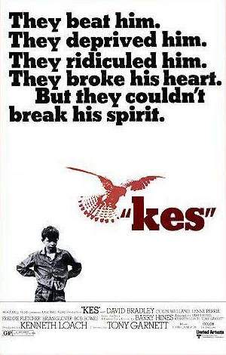
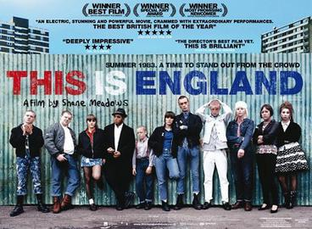
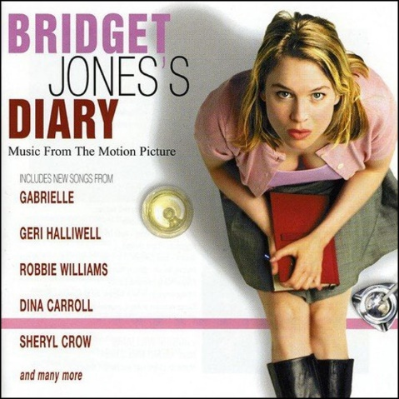
Conception of the Cinema
The 7th Art
Mean of Communication
A Show
A cultural Product
The mail goal is to create an artistic material or immaterial object for aesthetic purposes; ,, provoking feelings and emotions in the audience.
This is achieved by using a great variety of codes and channels which imply both verbal and non verbal language (music, image, facial and body gesture)
Just as what the radio, the newspaper or the television does. Its goal is not only to transmit emotions but also information.
Cinema is though as a more mean of communication since performance-reflection is greater due to the fact that cinemas are in dark and silence which enhances attention.
Where the main objective is to provoke on the audience a mixture of feelings such as joy, fear, anger, disgust…
A cultural product that recreates personal and social life
Source:
http://repositorio.udec.cl/bitstream/11594/2405/3/Tesis_Escritura_de_criticas_de_cine_en_septimo_a%C3%B1o.pdf

Slide 3
Film criticism
What is cinema criticism?
Orientate viewers
Does it fulfils its aim? Entertainment? Education?
Analysis of certain aspects
Genre
Development of the story
Acting
Story itself
Clothing
Technology and special effects
Scenery (photography
Structure
Proposal of thesis
Share ideas based on the most relevant film aspects (topic, the story, the plausibility, the genre…)
Technical aspects: direction, acting, scenery, special effects
Data sheet
Source:
http://repositorio.udec.cl/bitstream/11594/2405/3/Tesis_Escritura_de_criticas_de_cine_en_septimo_a%C3%B1o.pdf

Slide 4
Another type of criticism from the Press point of view.
Academic criticism:
It is often an exercises of understanding the particular work of the artist from a theoretical perspective, and afterwards try to and to find its transcendence in the history of art.
Press criticism in relation with the history, culture, theory and aesthetic of the cinema :
This sort of criticism is the one we found in newspapers or magazines (ABC, El País, Fotogramas…)
Press criticism focuses more on issues such as gender, style, structure…
Press criticism conceives cinema criticism as a sort of subgenre of art criticism.
As a matter of fact, Press criticism is then understood as a sort of commentary of the film, such like an editorial or a press article.
What are the features of the press criticism?
Abundance of rhetorical figures and argumentative text.
Types of Press criticism:
Analytic: it deepen on the structure of the film and it is more informative.
Laudatory: it overpraises a specific moment of the film.
Descriptive: it is just a mere description of the film, there’s no analysis, just a summary.
Expositive: it focuses on the director of the film and how the social, artistic and even cultural repercussion.
Aesthetic: it focuses on what gets the audience excited and how they feel when contemplating a work of art
Cinema criticism as a exercise of comprehension of the film performance
Source:
https://dadun.unav.edu/bitstream/10171/20597/1/El%20papel%20de%20la%20cr%C3%ADtica%20cinematogr%C3%A1fica.pdf
https://www.britannica.com/art/art-criticism

Slide 5
Film criticism
New Criticism:
Objective approach, trying to analyse the form of the text.
The emphasis is put on imagery, metaphor, or symbolism.
It does not take into account the context.
Feminism:
Concentrates on the implications and contradictions of gender roles.
How authority and acquiescence are presented in texts
Postcolonial Criticism:
How Western culture portraits the rest of the world: Are there stereotypes that reinforces its supremacy?
Structuralism:
Study text according to context.
How economic, social, and political issues structures the text.
Psychoanalytical Criticism:
Focuses on psychological features of the work: why the author has written the text?
Marxist Criticism:
Focuses on how texts reflects upon:
Clash of classes
Power relations
Social roles
Deconstruction:
There is no a unique analysis of the text because literary language is ambiguous.
Source:
https://courses.lumenlearning.com/suny-britlit1/chapter/literary-criticism/

Slide 6
Technical aspects of cinema: Direction
Direction:
His work begins with a literary script, which s/he will transform into a technical script with the necessary plans to shoot.
Then he will search for the locations.
Then he plans the budget and makes decision on it.
During filming, the director must guide the actors and decide where the camera is placed at all times
Subdirectors:
Production director: Report and detail the budget to the producer.
Casting director: choose the actors.
Art director: decide on the aesthetic aspects of the film.
When the role of director and scriptwriter are developed by the same person, it is called auteur cinema:
Alfred Hitcock
David Lean
Bill Douglas
Ken Loach
Stephen Frears
Mike Leigh
Source:
https://courses.lumenlearning.com/suny-britlit1/chapter/literary-criticism/

Slide 7
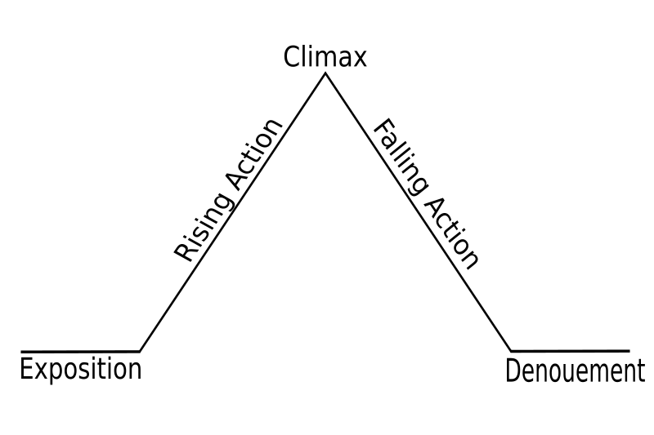
Technical aspects of cinema: The Script
It is made of 3 elements (Donoso y Barra, 2008: 144) :
Logos: speech supported by the word or verbal disposition of the script.
Pathos: action turned into conflict and that generates events.
Ethos: ultimate meaning of the story, reason for writing, questions and answers.
The structure of the script:
The beginning: general information on the protagonist and his or her conflict.
The action: a challenging moment which affects directly the protagonist giving a new perspective and forcing the protagonist to move on.
The end: its main goal is to give a sort of explanation to the story reinforcing the coherence of it.
Freytags pyramid. S.f. Wikipedia. Recuperado de: https://commons.wikimedia.org/wiki/File:Freytags_pyramid.svg
Source:
https://courses.lumenlearning.com/suny-britlit1/chapter/literary-criticism/

Slide 8
Technical aspects of cinema: types of Shots
The Extreme Wide Shot:
Used when the director gives more relevance to the setting more than to a specific detail.
Shown at the beginning of the film so the audience get an idea of the time and the place of the film they are about to watch in the next two hours.
A wide shot:
When the director wants the characters to be seen from head to toe in relation to the location.
Used to give the audience a sense of geography and so understanding where is each character.
A full shot:
It focuses on the character’s body, from head to toes.
Used to convey some information about the character: how she/he dresses or how she/he moves.
Some information about the character is revealed but not all.
Medium shot:
Showing the character from waist to head.
Used in dialog scenes.
Used to make the audience aware of the body language of the characters.
Close-up shot:
Shows the character’s feelings.
It focuses on emotional clues like eyes, forehead, smile…
The shot is more intimate and wants the audience to experience the same feeling as the character is experimenting.
Extreme Close-up shot:
Focuses on a specific facial feature.
It is an uncomfortable close and it is made to make the viewer understand what the actor wants to transmit.
Source:
https://www.careersinfilm.com/types-of-shots-in-film/

Slide 9
Technical aspects of cinema: Light
The light is used:
to express feelings.
to create an atmosphere.
In the same scene, establish different frames
To Highlight the depth of the scene.
Lighting can be:
Natural light
Artificial light
Hard light
Soft light
Analyze the following scene:
How is light dealt in the scene?
Bright? gloomy and dark? Combined? with light contrasts? Why?
Is he setting achieved? Is it natural, artificial? Does it fit the story being told?
Source:
https://es.slideshare.net/ampalagolo60/aspectos-tcnicos-del-cine

Slide 10
Technical aspects of cinema: The Clothing
Difference with the theatre:
In Cinema the tendency is to reproduce exactly the clothing of the moment.
Cinema gives a great importance to characterisation since it understands cinema as a whole Venture of story, scenary, clothing and sound.
In theatre what it really is important is the message, whereas in cinema the plot and the message is important but also the entertainment.
Types of Clothing:
Realistic: costumes are designed according to historical reality. The tailor is previously informed in documents of the time and makes the accuracy of the clothing a priority.
Pararealistic: The tailor has been inspired by documents of the time, but has proceeded to a stylization. The concern for the beauty or spectacular nature of the clothing is above historical accuracy.
Symbolic: The costumes serve, fundamentally, to symbolically translate the characters' characters, their social class or states of mind.
Source:
https://es.slideshare.net/ampalagolo60/aspectos-tcnicos-del-cine

Slide 11
Technical aspects of cinema: The Sound
Realism:
Sounds brings realism to the cinema.
Flow of scenes:
Sound gives continuity to scenes.
It is a mechanism to achieve unity.
It is a resource of not using any word, but to still mean something.
It allows to give prominence to action scenes
Uses:
Used as a counterpoint to the image.
Necessity of matching between image and music. Otherwise, lack o sense. Failed to communicate the emotion of the scene.
Replace a real noise.
Highlight a moment in the scene.
Compare the use:
Chariots of Fire
Nothing Hill
Green Street Hooligans
A Clockwork Orange
Does it accompany, enhance or oppose the image?
Are there different sound planes, what sounds are there?
Are there dialogues?
How important are they?
What role do silences play in the construction of the environment?
Source:
https://es.slideshare.net/ampalagolo60/aspectos-tcnicos-del-cine

Slide 12
Technical aspects of cinema: The Sound
Functions:
Rhythmic function:
Music is used as a counterpoint to the image.
The duration of the image and the musical phrase have to match.
Full Monty
Dramatic Function:
Music is used as an element that can be useful for the viewer to understand the meaning of the action.
Kess
Source:
https://es.slideshare.net/ampalagolo60/aspectos-tcnicos-del-cine

Slide 13
Technical aspects of cinema: The Scenery
Types:
Interior/Exterior
Artificial/ Realistic
Differentiate between:
Impressionist:
Scenery has no symbolism, it only means what it is.
Typical set of Soviet cinema and cinema "made in" Hollywood.
Scenery is chosen according to the psychological feature of the scene.
Scenery chosen to reveal the state of mind of the characters or their conflicts.
Decorations are usually natural.
Expressionist:
Scenery is subjective.
Distortion is predominant
Scenery is artificial, because the aim is to offer the audience a distorted vision of reality.
It is aimed to conjure feelings of mystery, alienation, disharmony and destabilization
Source:
https://es.slideshare.net/ampalagolo60/aspectos-tcnicos-del-cine

Slide 14
Technical aspects of cinema: Types of acting Ways
Hieratic acting/ Classical Acting:
Stylized, theatrical.
Actors had to learn and practice their skills on stage.
It is a sort of overacting
Restraint acting:
Emphasizes the presence of the actor.
The interpretation reduces the gestures and the speed of the dialogues.
Dynamic acting:
Gestural and verbal explosion predominates.
Source:
https://es.slideshare.net/ampalagolo60/aspectos-tcnicos-del-cine

Slide 15
Technical aspects of cinema: Putting together the film
It is the process by which the shots and sequences of a film are ordered according to the criteria of the director.
It is influences by the rhythm established in the script.
It is commonly referred as the “cut of shots”. In a film there are many different shots, but when the film is made, the director chooses the shots he wants.
Among the factors that influences a film there are 2 that are relevant to focus on: the scale and duration of the shot
According to these two factors, a film can be read as:
Analytical: use of short shots to convey a short duration. This is done to highline the expression as well as the psychological tension of the scene.
Synthetic: use of long shots, specially the extreme wide shots. In this way, the director achieves to show a much more complete vision of reality. There is no need of analysis, whereas in the analytical, the audience has to ask “What is happening?”.
Types of film according to how the author puts together the shots:
Narrative: the facts are told either chronologically or making jumps both to the future or to the past. However, the aim of the film is always to tell a story.
Expressive: in this sort of film what if prevails is the aesthetics of the film. All elements of the film ( performances, movement, sound, shots, frame) are subdued to the aesthetic of the film. The target is to awaken different emotions in the spectators.
Source:
http://www.cineddhh.org/guias-didacticas/como-ver-una-pelicula-educacion-primaria/2-las-imagenes-y-el-sonido/2b-el-montaje/#g

Slide 16
Practice
You are going to criticize and compare certain scenes of British films.
You will have to analyze the films following this structure:
Is there any critic under which you have analyzed the film?
Analyze the type of shots-is there any overuse of shots? Why? Why not?
Analyze the clothing, how does it influence the film? Is it more realistic?
Sound: analyze:
How does it affect the scene
What is its function in the scene
The Scenery: what is the intention of the director in it?
What sort of film do you think is it?
Narrative/ Expressive
Analytical /Synthetic
Is there any specific British cultural feature that you can observe in the film?

Slide 17
Practice
Film 1
Film 2
Film 3
Film 4
Film 5
Film 6
Film 7
Film 8
Film 9
Film 10

Slide 18
Anónimo. 2016. Aspectos técnicos del cine. Slideshare. Recuperado de: https://es.slideshare.net/ampalagolo60/aspectos-tcnicos-del-cine Anónimo. s.f. Como hacer una critica de cine. Foerderverein. Recuperado de: https://www.foerderverein-filmkultur.de/content/uploads/filmkritik_spanisch1.pdf Anónimo. s.f. El cine, el mundo y los derechos humanos. cineddhh. Recuperado de: http://www.cineddhh.org/guias-didacticas/como-ver-una-pelicula-educacion-primaria/2-las-imagenes-y-el-sonido/2b-el-montaje/#g Anónimo. s.f. Literary Criticism. ERservices. Recuperado de: https://courses.lumenlearning.com/suny-britlit1/chapter/literary-criticism/ Burton Kuspit, Donald. 2021. Art criticism. Britanica. Recuperado de: https://www.britannica.com/art/art-criticism Calhoun, Dave y de Semlyen, Phil Friday. 2021. The 100 best British movies. TimeOut. Recuperado de: https://www.timeout.com/film/100-best-british-films Contis, Eva. 2019. Types of Shots in a Film: The First Tools to Building a Shot List. Careers in Film. Recuperado de: https://www.careersinfilm.com/types-of-shots-in-film/ Green, Willow. 2021. The 100 Best British Films. Empire. Recuperado de: https://www.empireonline.com/movies/features/best-british-films/ Hoyle, Brian. 2006. British Art Cinema 1975-2000: Context and Practice. B.A. University of Hull. Recuperado de: https://core.ac.uk/download/pdf/8821052.pdf Loach, Ken. 2009. The Observer Film Quarterly's best British films of the last 25 years. The Guardian. Recuperado de: https://www.theguardian.com/film/gallery/2009/aug/30/best-british-films-25-years Roddick, Chloe. The 12 Classic British Directors You Need to Know About 2015. MoreliaFilmFestival. Recuperado de: https://moreliafilmfest.com/en/los-12-directores-britanicos-clasicos-que-necesitas-conocer/ Selter, Emily. 2020. 22 Quintessentially British Movies to Cheer You Up. Town and Country. Recuperado de: https://www.townandcountrymag.com/leisure/arts-and-culture/g9139292/best-british-movies-films/ Solar Elgueta, Dariolette. 2016. escritura de críticas de cine en séptimo año: representaciones sociales en torno a la ficción y la realidad. Universidad de Concepción. Recuperado de: http://repositorio.udec.cl/bitstream/11594/2405/3/Tesis_Escritura_de_criticas_de_cine_en_septimo_a%C3%B1o.pdf Verano Esqueda, Lourdes y Noguera Tajadura, María. S.f. El papel de la crítica cinematográfica en el panorama audiovisual contemporáneo. Universidad de Navarra. Recuperado de: https://dadun.unav.edu/bitstream/10171/20597/1/El%20papel%20de%20la%20cr%C3%ADtica%20cinematogr%C3%A1fica.pdf
Webgraphy

