Slide 1
Netiquette
What`s that?
By Alesander Guzmán Arenaza

Slide 2
Netiquette is etiquette on the Internet.

Slide 3
Advices
Netiquette

Slide 4
No spamming
Electronic spamming is the use of electronic messaging systems to send an unsolicited message (spam), especially advertising, as well as sending messages repeatedly on the same site.
Netiquette

Slide 5
No flaming
Flaming is a hostile and insulting interaction between persons over the internet, often involving the use of profanity. It can also be the swapping of insults back and forth or with many people teaming up on a single victim.
Netiquette

Slide 6
READ THE TERMS OF USE IN ANY WEBSITE
Netiquette

Slide 7
DON’T TYPE IN ALL CAPS
That means you are shouting
Netiquette

Slide 8
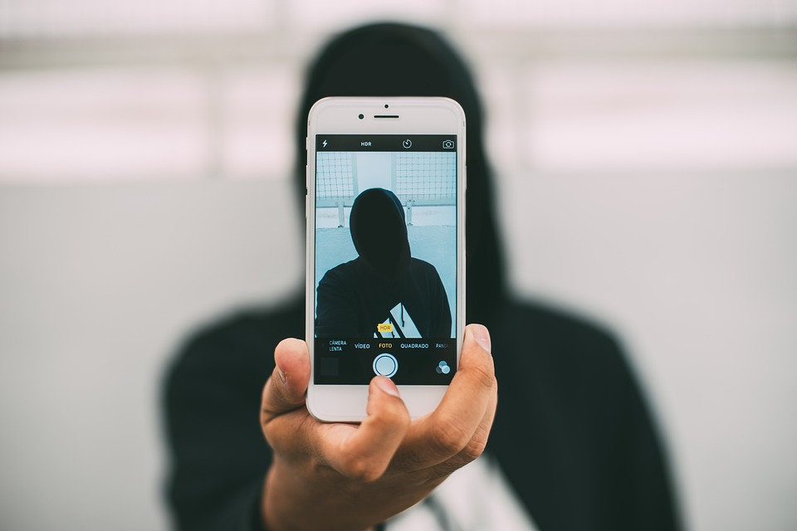
DON’T ABUSE WEB ANONYMITY
That means you are shouting
Netiquette

Slide 9
THE CORE RULES OF NETIQUETTE
Netiquette

Slide 10
ACTIVITY ABOUT NETIQUETTE
Netiquette

Slide 11
NETIQUETTE
Netiquette

Slide 12
All pictures have taken from pixabay
Text have been extracted from wikipedia
Netiquette

