Slide 1
ISFEC Aquitaine
France
Jean-Baptiste Arrizabalaga, Laura Brochet & Christine Fröhlich

Slide 2
1. Teacher training activities and projects organized by ISFEC Aquitaine in a recent period related to mobile learning implementation
A project including initial and continuous training
An advisor specialist in digital pedagogy since september 2018
ISFEC 2.0. Aquitaine global project aim - renoval of training sessions:
Active pedagogies
Numeric devices
Collaborative training & collective intelligence
Responsability
Always linked with professional reality, needs and constraints

Slide 3
Training sessions
Initial training (students)
Continuous training (teachers)
First year: digital culture courses;
Second year: digital culture as used by teachers and digital competences to be developed with pupils, flipped classroom;
Research project with students of both years
Catalogue sessions (1 or 2 days): digital culture as used by teachers and digital competences to be developed with pupils, flipped classroom, media literacy;
School project (4 sessions per year, with distance accompanying): training to the pedagogical use of digital devices (tablets with securised special system)

Slide 4
Digital Tools used by ISFEC
E-learning platform: Itslearning https://isfecaquitaine.itslearning.com/
Communication and virtual classroom: Adobe connect
Interactive presentation: Beekast
Others…

Slide 5
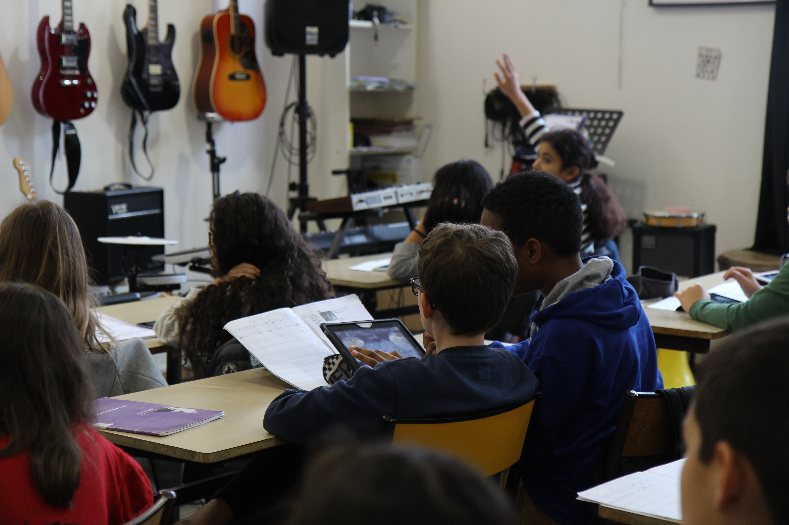
2. Interesting activities, projects, experiences, carried out in Aquitaine' schools
The existing
Collège Saint Louis, Sainte Thérèse, Bordeaux: flipped classroom, learning with tablets : http://www.sthelo.com/
Immaculée Conception, Biarritz : https://immac-btz.fr/la-robotique-au-college/
Collège Saint Vincent, Hendaye: tablets and cooperative pedagogy
Groupe Jean Cassaigne, Mont-de-Marsan: tablets
Others…

Slide 6
2. Interesting activities, projects, experiences, carried out in Aquitaine' schools
Developped with ISFEC Aquitaine
Ecole Saint-Jean à Pauillac: tablets (using tablets in a pedagogical way)
Collège du Mirail, Bordeaux: tablets for pedagogy
Ecole Saint François Xavier, Gradignan: numeric devices for inclusion (public with specific needs)

Slide 7
3. Proposals for training improvement in ISFEC in short terms
TEACHER
Speed learning
Social learning
Video learning
Live training sessions
Flipped classroom
This year… Reflection, experimentations, improvement

Slide 8
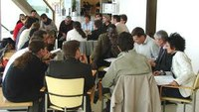
Our future projects
Partnerships : cadre 21 (Canada): e-learning training sessions https://www.cadre21.org/
Training certification : 4 levels (explore/ create/ practice and analyse/ train)
A new training classroom with 4 projection points, mobile tables, to influence the active pedagogy and collaboration (to be published…)

