Slide 1
CLIL:
SCIENCE IN PRIMARY

Slide 2
SCIENCE
CONTENTS
ACTIVITIES
VOCABULARY
ASSESSMENT
LANGUAGE IN CLASS
TASKS

Slide 3
CONTENTS
We are going to focus on five different topics we can work with our students through Primary Education.

Slide 4
CONTENTS
UNIT 1: SENSES
UNIT 2: WE CAN MOVE
UNIT 3: FOOD AND HEALTH
UNIT 4: ANIMALS
UNIT 5: PLANTS

Slide 5
CONTENTS
UNIT 1: SENSES
Nutrition, relation and reproduction.
Changes in the stages of life.
The senses.
The nervous system.
Function of the organs of the five senses.
Healthy habits.

Slide 6
ACTIVITIES
UNIT 1: SENSES
The Senses Song: motivate our students singing a song about the five senses.
The life cycle: show images of people at different stages of life.
Blind Man’s Buff: investigate with the senses of hearing and touch through a game.

Slide 7
ACTIVITIES
UNIT 1: SENSES
How does it feel: value the importance of the sense of touch. Pupils have to find out the object just just through the sense of touch.
Worksheet reinforment. Draw and label living things and non living things. Match sentences with pictures of vital processes.

Slide 8
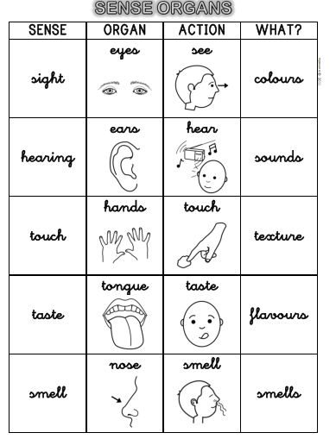
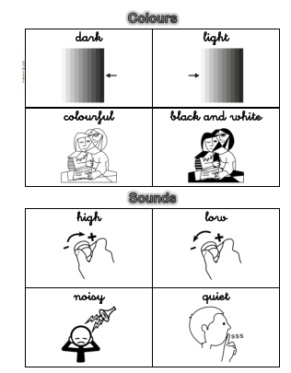
VOCABULARY
UNIT 1: SENSES

Slide 9
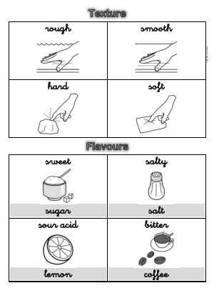
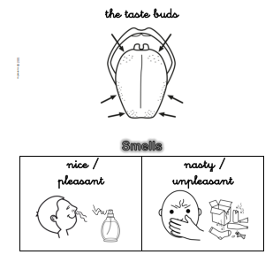
VOCABULARY
UNIT 1: SENSES

Slide 10
ASSESSMENT
UNIT 1: SENSES
Explain how the senses are used.
Understand the processes of life.
Understand the interaction between brain and the senses.

Slide 11
CONTENTS
UNIT 2: WE CAN MOVE
The skeleton and the bones.
The joints.
The muscles.
The breathing system.
The digestive system.
The circulatory system.
The excretory system.
The reproductive system.

Slide 12
ACTIVITIES
UNIT 2: WE CAN MOVE
The Skeleton Dance: motivate our pupils to know about the locomotor system and our joings in order to move.
Simon Says!: to know about your body movement.
What’s inside my body: understand the different part of our body through a video.

Slide 13
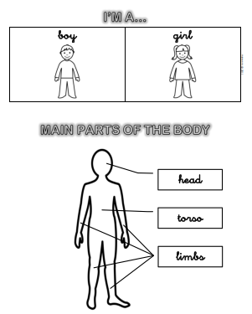
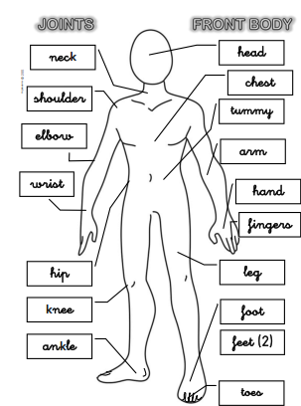
VOCABULARY
UNIT 2: WE CAN MOVE

Slide 14
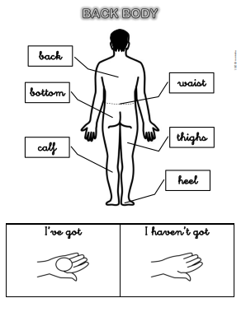
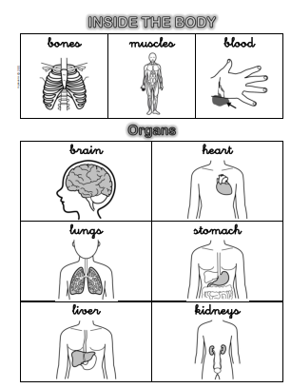
VOCABULARY
UNIT 2: WE CAN MOVE

Slide 15
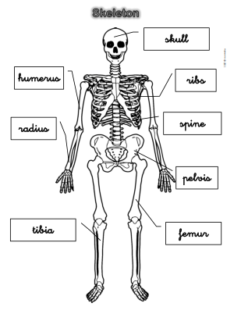
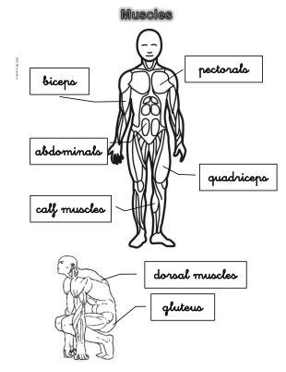
VOCABULARY
UNIT 2: WE CAN MOVE

Slide 16
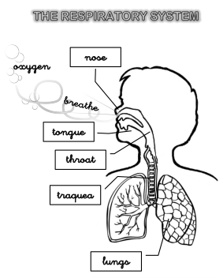
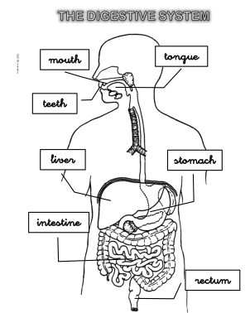
VOCABULARY
UNIT 2: WE CAN MOVE

Slide 17
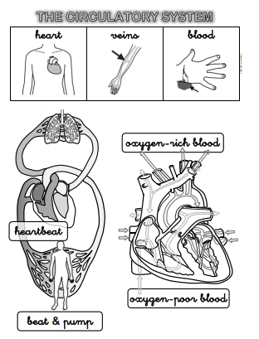
VOCABULARY
UNIT 2: WE CAN MOVE

Slide 18
ASSESSMENT
UNIT 2: WE CAN MOVE
Knowledge of the function of the organs, aparatous and systems of the human body.
Description of the locomotor, digestive, circulatory, excretory and reproductive.
Learn about the organs of the different systems.

Slide 19
CONTENTS
UNIT 3: FOOD AND HEALTH
Groups of foods and its nutrients.
Food pyramid.
Healthy diet.
Healthy eating habits.

Slide 20
ACTIVITIES
UNIT 3: FOOD AND HEALTH
Favourite food song: Learn songs about food.
Food origin: work in teams to learn about the origin of food.
Nutrition pyramid: reinforce the knowledge of groups of food.
Worksheets.

Slide 21
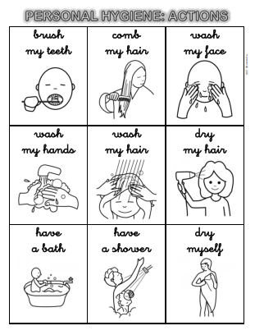
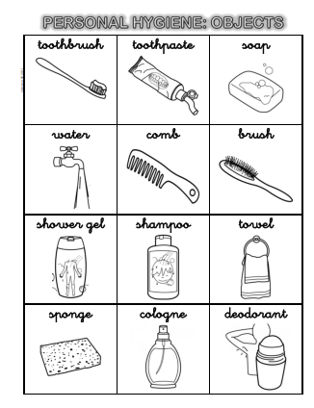
VOCABULARY
UNIT 3: FOOD AND HEALTH
Notes:
Food

Slide 22
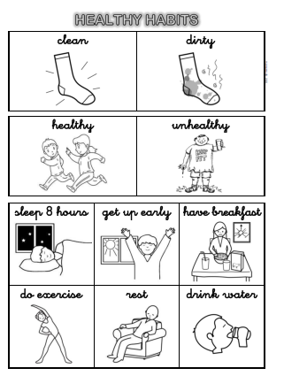
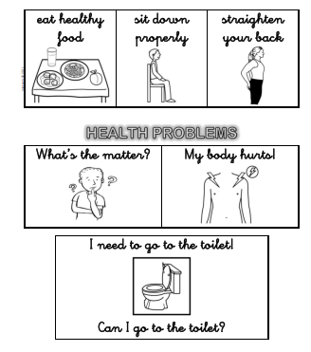
VOCABULARY
UNIT 3: FOOD AND HEALTH
Notes:
Food

Slide 23
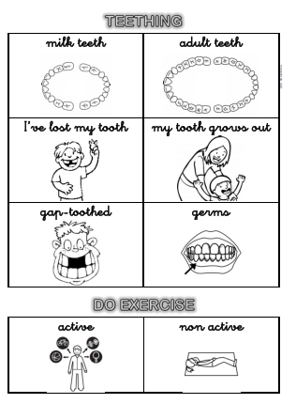
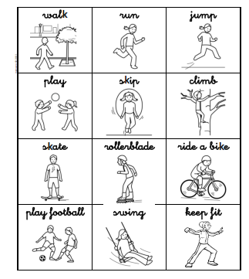
VOCABULARY
UNIT 3: FOOD AND HEALTH
Notes:
Food

Slide 24
ASSESSEMENT
UNIT 3: FOOD AND HEALTH
Identity different types of foods.
Good habits of of hygiene, food and physical exercise.
Understand the origin of food.

Slide 25
CONTENTS
UNIT 4: ANIMALS
Vertebrate and invertebrate animals. Classification and characteristics.
Nutritions, relations and reproductions of animals.
Habits of respect and care of animals.

Slide 26
ACTIVITIES
UNIT 4: ANIMALS
If I were an animal: song about animals.
Vertebrates and invertebrates: draw and colour pictures of animals.
Worsheet reinforcement:
Match definitions with the animals.
Classify animals in the group they belong to.

Slide 27
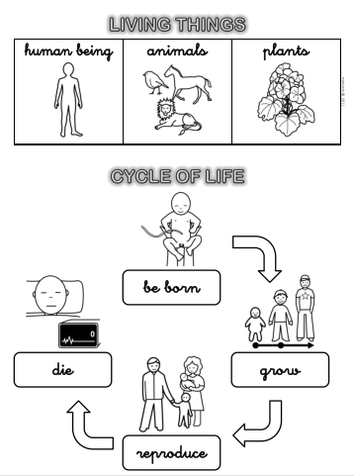
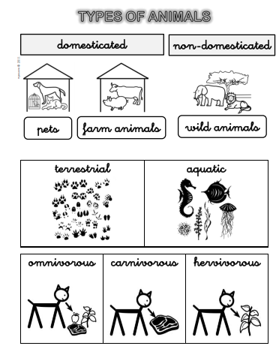
VOCABULARY
UNIT 4: ANIMALS
Notes:
Food

Slide 28
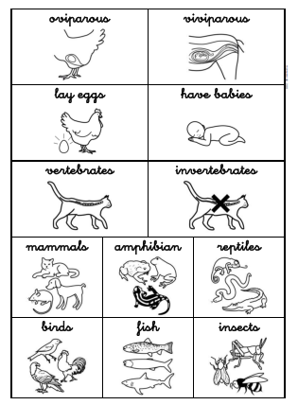
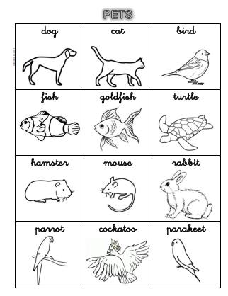
VOCABULARY
UNIT 4: ANIMALS
Notes:
Food

Slide 29
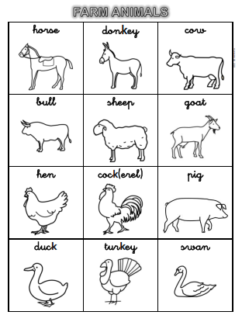
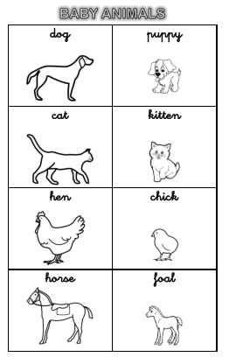
VOCABULARY
UNIT 4: ANIMALS
Notes:
Food

Slide 30
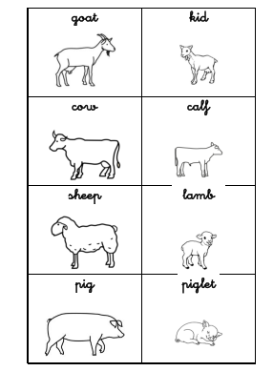
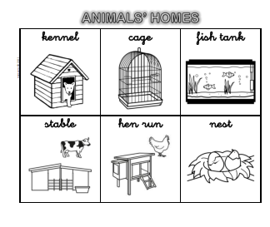
VOCABULARY
UNIT 4: ANIMALS
Notes:
Food

Slide 31
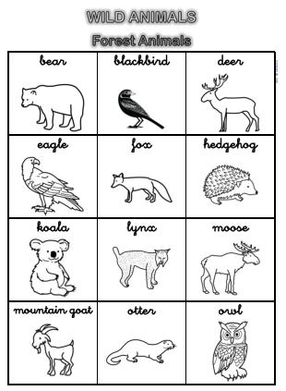
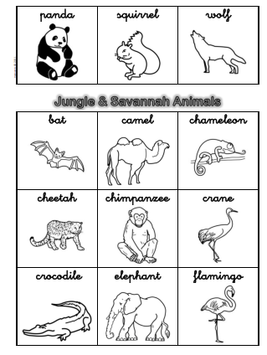
VOCABULARY
UNIT 4: ANIMALS
Notes:
Food

Slide 32
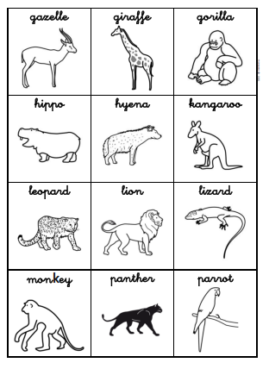
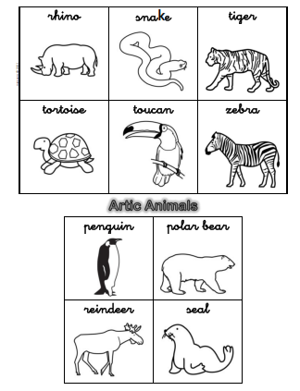
VOCABULARY
UNIT 4: ANIMALS
Notes:
Food

Slide 33
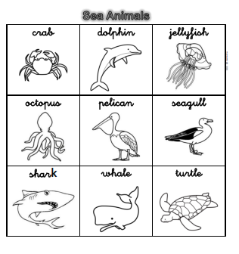
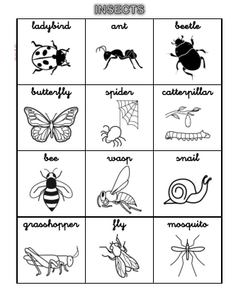
VOCABULARY
UNIT 4: ANIMALS
Notes:
Food

Slide 34
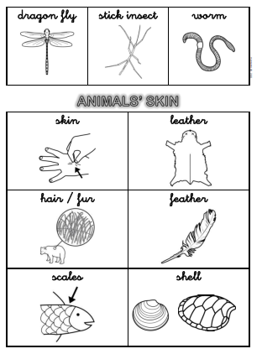
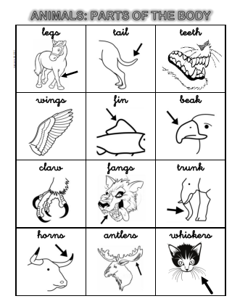
VOCABULARY
UNIT 4: ANIMALS
Notes:
Food

Slide 35
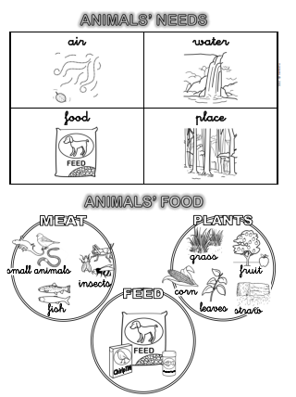
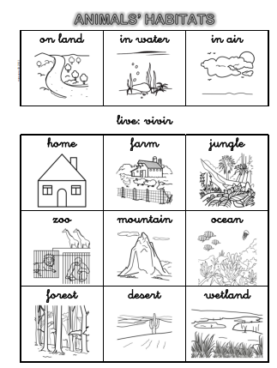
VOCABULARY
UNIT 4: ANIMALS
Notes:
Food

Slide 36
ASSESSMENT
UNIT 4: ANIMALS
Describe the characteristics of vertebrate and invertebrate animals.
Vertebrates and invertebrates: draw and colour pictures of animals.

Slide 37
CONTENTS
UNIT 5: PLANTS
Plants: structure and physiology.
The vital cycle of plants.
Kind of plants and characteristics.
Reproduction of plants.

Slide 38
ACTIVITIES
UNIT 5: PLANTS
The needs of a plant: motivate our students with a song about plants.
Where is/are the…: through flashcards, our students have to recognize the different part of a plant.
Planting peas: observe the vital cycle of a pea.

Slide 39
ACTIVITIES
UNIT 5: PLANTS
Let’s go for a walk: recognize and describe the different plants around us.
Flowers: recognize and labe the different parts of a flower.
Make a presentation: create a mural, power point, etc with the infromation about the unit

Slide 40
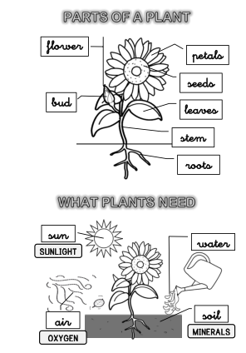
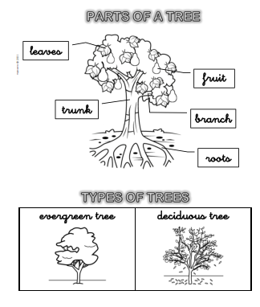
VOCABULARY
UNIT 5: PLANTS
Notes:
Food

Slide 41
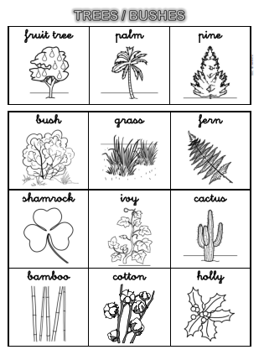
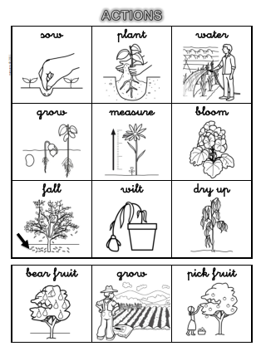
VOCABULARY
UNIT 5: PLANTS
Notes:
Food

Slide 42
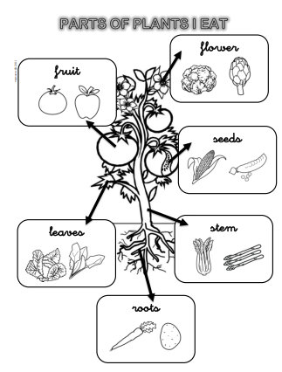
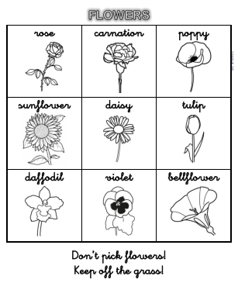
VOCABULARY
UNIT 5: PLANTS
Notes:
Food

Slide 43
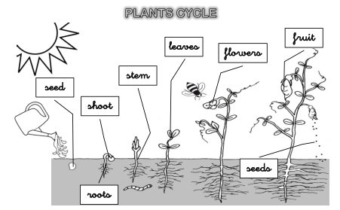
VOCABULARY
UNIT 5: PLANTS
Notes:
Food

Slide 44
ASESSMENT
UNIT 5: PLANTS
Explain nutrition and reproduction of plants.
Classify and describe plants.

Slide 45
LANGUAGE IN CLASS
Now, it is time to learn about the general vocabulary we can use in the Science class with our students in any topic dealt with in the course.

Slide 46
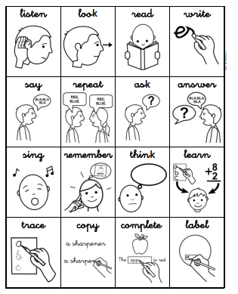
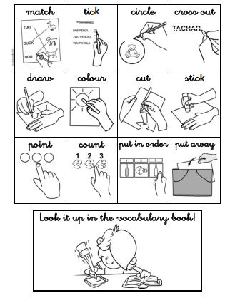
LANGUAGE IN CLASS

Slide 47
TASK 0
TASK O. Before starting this course you have to do two things:
Introduce yourself in the forum of the course (it is important you have your own
picture in order the rest of your classmates can see your face)
Make a presentation about yourself in which you have to include:
Three hobbies you have.
Two of your favourite activities in the English class
One job you would have if you were not a TEACHER.
To make your presentation you can use any Web 2.0 tool such as (PREZZI,
GENIALLY, EMAZE, etc…)
When you have done both things, send a message to your tutor saying you have
taken part in the forum and send him/her your presentation.
You can send your presentation on the twitter course. (OPTIONAL)

Slide 48
TASK 1
TASK 1 Write the advantages and disadvantages of teaching Science in English to your pupils. Try to develop your ideas about new technologies, difficulties your pupils have to, ways to encourage them in the learning of the area, etc. Send it to your tutor.

Slide 49
TASK 2
TASK 2. Choose one Science content of the course and develop extra activities to work with your students focused on that topic. Try to make your presentation attractive using tools such as Prezi, Emaze or any other you want to. Once you have published your presentation, send the URL to your tutor.

Slide 50
TASK 3
TASK 3. Your final task will be to create a questionaire and a presentation to your pupils based on any content studied in the course. You can use google form and google presentation or optionally any on line tool such as:
https://www.onlinequizcreator.com/es/
http://www.triviaplaza.com/
https://www.canva.com/es_es/crear/presentaciones/
http://www.slidescarnival.com/es/
Finally, send the URL of your questionare and presentation to your tutor.

